Slide 1

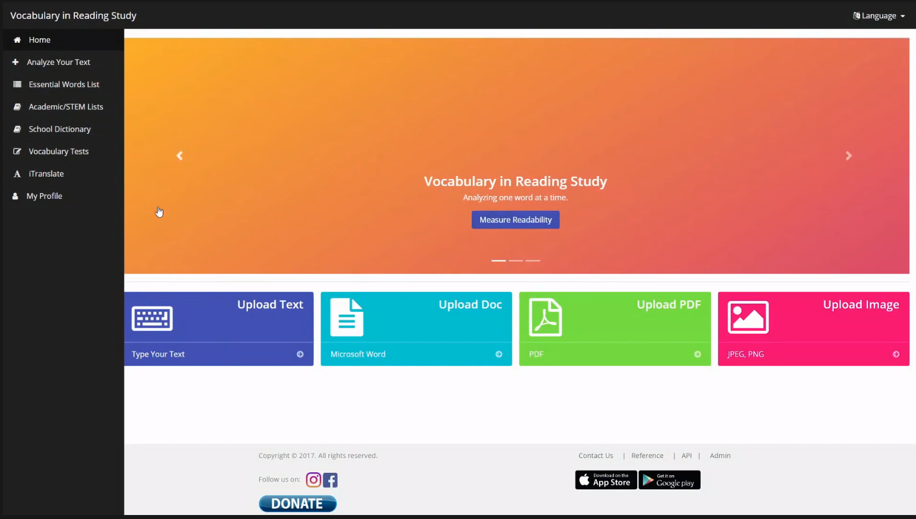
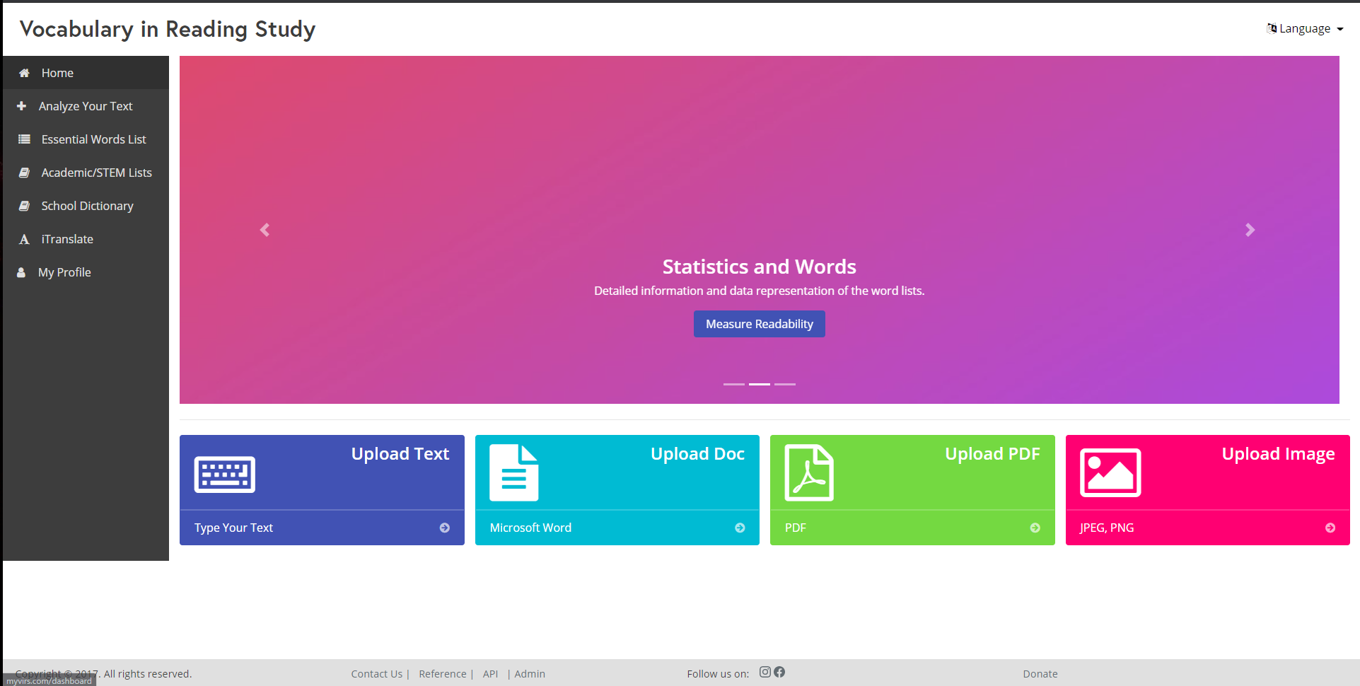
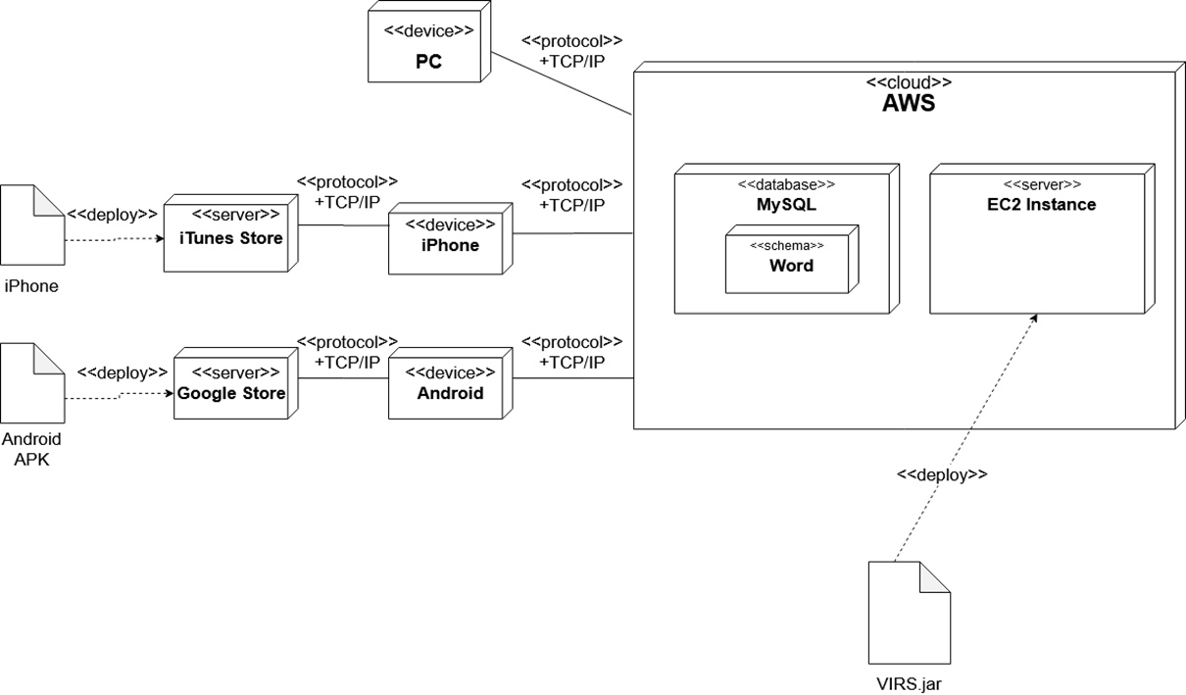
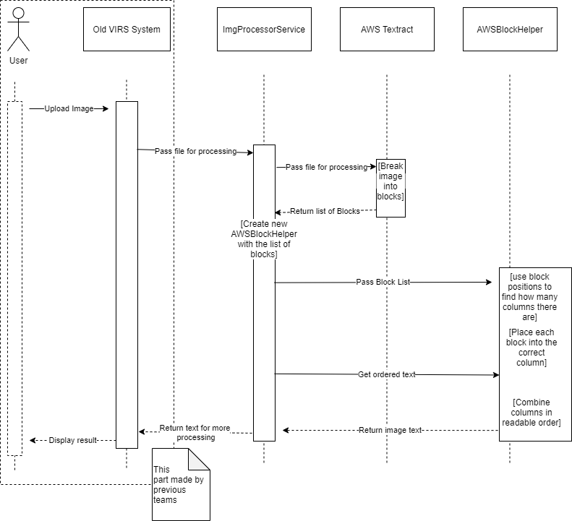

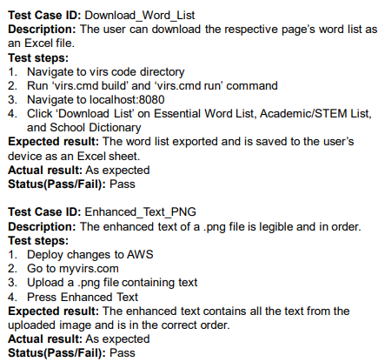
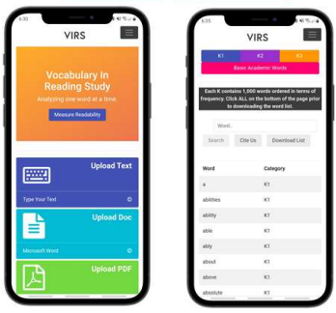
Knight Foundation School of Computing
& Information Sciences
Spring 2021 Senior Design Project
Vocabulary In Reading Study
Students: Javier Duenas
Mentor: Seyedjafar Ehsanzadehsorati
Instructor: Dr. Masoud Sadjadi, Florida International University
Problem
Figure 1 – Old Design
Requirements
Current System
I needed to find a solution that VIRS can be available in app form. I am experience with iOS development, so I decided to make a quick app in xcode for VIRS but ran into issues which I later found out is because apple does not allow for loading of unsecure websites. So, when VIRS becomes secure the app will work.
Users that forget username had no way of getting their username.
Forgot password was also not functioning.
Images with symbols have trouble when image processing
Layout of VIRS had clipping issues on some text and other items.
No android or iOS app available for VIRS
Figure 2 – New Design
System Design
Object Design
Implementation
I made an iOS app that will work when the website is secure along with logos for the app for all the different sizes. The logo can always be changed later.
Figure 4 – VIRS iOS logo(first draft)
Figure 3 – Provided by previous groups
The site is hosted on AWS and the
mobile apps display the site through
a WebView object.
The Frontend consists of Angular Typescript, Bootstrap, CSS and HTML5
The backend is Java SpringBoot and MySQL.
Figure 5 – Sequence Diagram
Verification
Screenshots
Summary
I created an iOS app using xCode and swift in order to bring VIRS to the Appstore.
I helped with the issue of not being able to get the users username if they were to forget it.
I created a logo for the iOS app to use.
The app will not fully function until the website becomes secure.
This is how the app is supposed to function. Exactly the same as the website version on the phone, but in app form instead for user convenience,.
*Credit to Regine Donatien
Acknowledgement
I thank Seyedjafar Ehsanzadehsorati for assistance, cooperation and mentorship that I received throughout this process.

